Slide 1
joeq compiler system
Benjamin Livshits
CS 243

Slide 2
Plan for Today
Joeq System Overview
Lifecycle of Analyzed Code
Source Code Representation
Writing and Running a Pass
Assignment: Dataflow Framework

Slide 3
1. Background on joeq
A compiler system for analyzing Java code
  Developed by John Whaley and others
  Used on a daily basis by the SUIF compiler group
  An infrastructure for many research projects: 10+ papers rely on joeq implementations
Visit http://joeq.sourceforge.net for more…
Or read http://www.stanford.edu/~jwhaley/papers/ivme03.pdf

Slide 4
joeq Design Choices
Most of the system is implemented in pure Java
Thus, analysis framework and bytecode processors work everywhere
For the purpose of programming assignment, we treat joeq as a front- and middle end
But it can be used as a VM as well
  System-specific code is patched in when the joeq system compiles itself or its own runtime
  These are ordinary C routines
  Systems supported by full version: Linux and Windows under x86

Slide 5
joeq Components
Full system is very large: ~100,000 lines of code
Allocator
Bootstrapper
Classfile structure
Compiler (Quad)
Garbage Collector
Quad Interpreters
Memory Access
Safe/Unsafe barriers
Synchronization
Assembler
Class Library
Compiler (Bytecode)
Debugger
Bytecode Interpreters
Linkers
Reflection support
Scheduling
UTF-8 Support
We restrict ourselves to only the compiler and classfile routines,
which is closer to 40,000 lines of code

Slide 6
Starting at the Source

Slide 7
Lifecycle of Analyzed Code
Everything begins as source code
A very “rich” representation
  Good for reading
  Hard to analyze
Lots of high-level concepts here with (probably) no counterparts in the hardware
  Virtual function calls
  Direct use of monitors and condition variables
  Exceptions
  Reflection
  Anonymous classes
  Threads

Slide 8
Source to Bytecode
javac or jikes compiles source into a machine-independent bytecode format
This still keeps the coarse structure of the program
  Each class is a file
  Split up into methods and fields
  The bytecodes themselves are stored as a member attribute in methods that have them
  Bytecoded instructions are themselves high level:
    invokevirtual
    monitorenter
    arraylength

Slide 9
Analysis and Source Code
Because so much of the code structure stays in the classfile format, there's no need for Java analyzers to bother with source code at all
Moreover, bytecode is indifferent to language changes
Reading in code:
  joeq searches through the ordinary classpath to find and load requested files
  Each source component in the classfile has a corresponding object representing it:
    jq_Class
    jq_Method
    etc.
Method bodies are transformed from bytecode arrays to more convenient representations:
  more on this later

Slide 10
How Source Code is Represented within joeq

Slide 11
Source Code Representation
joeq is designed primarily to work with Java
  Operates at all levels of abstraction
  Has classes corresponding to each language component
Relevant packages in joeq
  joeq.Class package: classes that represent Java source components (classes, fields, methods, etc.) reside in joeq's
  Compil3r.BytecodeAnalysis package: analysis of Java bytecode
  Compil3r.Quad package: Classes relevant to joeq's internal “quad” format
Be careful with your imports:
  avoid name conflicts with java.lang.Class and java.lang.Compiler classes
Types/Classes
Fields/Methods
Basic blocks
Instructions

Slide 12
joeq.Class: Types and Classes
jq_Type: Corresponds to any Java type
jq_Primitive: subclass of jq_Type. Its elements (all static final fields with names like jq_Primitive.INT) represent the primitive types
jq_Array: array types. Multidimensional arrays have a component type that is itself a jq_Array
jq_Class: A defined class
… all located in package

Slide 13
joeq.Class: Fields and Methods
Subclasses of jq_Field and jq_Method, respectively
  Class hierarchy distinguishes between instance and class (static) members, but this detail is generally hidden from higher analyses
These classes know about their relevant types: who declares them, parameter/return types, etc.
Names of members are stored as UTF.Utf8 objects, so you'll need to convert them with toString() to get any use out of them!

Slide 14
Analyzing Bytecode
The Java Virtual Machine stores program code as bytecodes that serve as instructions to a stack machine of sorts
Raw material for all analysis of Java code
Preserves vast amounts of source information:
  Java decompilers can almost perfectly reconstruct source, down to variable names and line numbers

Slide 15
Example of Java Bytecode
class ExprTest {
int test(int a){
int b, c, d, e, f;
c = a + 10;
f = a + c;
if(f > 2){
f = f - c;
}
return f;
}
}
javac test.java
javap -c ExprTest
int test(int);
Code:
0: iload_1
1: bipush 10
3: iadd
4: istore_3
5: iload_1
6: iload_3
7: iadd
8: istore 6
10: iload 6
12: iconst_2
13: if_icmple 22
16: iload 6
18: iload_3
19: isub
20: istore 6
22: iload 6
24: ireturn

Slide 16
Bytecode Details
The implied running model of the Java Virtual Machine is that of a stack machine - there are local variables that correspond to registers, and a stack where all computation occurs.
  This is hard to analyze!
Fortunately, the JVM requires that bytecode pass strict typechecking and stack consistency checking
Gosling Property: At each instruction, the types of every element on the stack, and every local variable, are all well defined
By extension, the stack must have a specific height at each program point

Slide 17
Converting Bytecodes to Quads
joeq thus converts bytecodes to something closer to standard three-address code, called "Quads"
The highly abstract bytecode instructions for the most part have direct counterparts in the Quad representation
One operator, up to four operands
OPERATOR OP1 OP2 OP3 OP4
Approximately 100 operators, all told (filed into a dozen or so rough categories), about 15 varieties of operands
Full details on these and the methods appropriate to them on the course website's joeq documentation:
  http://suif.stanford.edu/~courses/cs243/joeq/

Slide 18
Operators
Types of operators
  Primitive operations: Moves, Adds, Bitwise AND, etc.
  Memory access: Getfields and Getstatic
  Control flow: Compares and conditional jumps, JSRs
  Method invocation: OO and traditional
Operators have suffixes indicating return type:
  ADD_I adds two integers.
  L, F, D, A, and V refer to longs, floats, doubles, references, and voids respectively
  Operators may have _DYNLINK (or %) appended, which means that a new class may need loading at that point

Slide 19
Operands
Operands are split into 15 types
  The ConstOperand classes (I, F, A, etc.) indicate constant values of the relevant type
  RegisterOperands name pseudo-registers
  MethodOperands and ParamListOperands are used to identify method targets
  TypeOperands are passed to type-checking operators, or to "new" operators
  TargetOperands indicate the target of a branch

Slide 20
Converting a Method to Quads
BB0 (ENTRY) (in: <none>, out: BB2)
BB2 (in: BB0 (ENTRY), out: BB3, BB4)
1 ADD_I T0 int, R1 int, IConst: 10
2 MOVE_I R3 int, T0 int
3 ADD_I T0 int, R1 int, R3 int
4 MOVE_I R6 int, T0 int
5 IFCMP_I R6 int, IConst: 2, LE, BB4
BB3 (in: BB2, out: BB4)
6 SUB_I T0 int, R6 int, R3 int
7 MOVE_I R6 int, T0 int
BB4 (in: BB2, BB3, out: BB1 (EXIT))
8 RETURN_I R6 int
BB1 (EXIT) (in: BB4, out: <none>)
Exception handlers: []
Register factory: Local: (I=7, F=7, L=7, D=7, A=7)
Stack: (I=2, F=2, L=2, D=2, A=2)

Slide 21
Control Flow and CFGs
The class Compil3r.Quad.ControlFlowGraph encapsulates most of the information we'll ever need for our analyses
  There's a a ControlFlowGraph in Compil3r.BytecodeAnalysis too, so be careful about your imports
These are generated from jq_Methods by the underlying system's machinery (the CodeCache class) -- we use them to make QuadIterators
(which we'll get to later)

Slide 22
Basic Blocks
Raw components of Control Flow Graphs
These know about their predecessors, successors, a list of Quads they contain, and information about exception handlers
  Which ones protect this basic block
  Which blocks this one protects
Traditional BB semantics are violated by exceptions:
  if an exception occurs, there is a jump from the middle of a basic block
  We will ignore this subtlety

Slide 23
Safety Checks
Java's safety checks are implicit: various instructions that do computation can also throw exceptions
Joeq's safety checks are explicit: arguments have their values tested by various operators like NullCheck and BoundsCheck
  Exceptions are thrown if checks fail
When converting from bytecodes to quads, all necessary checks are automatically inserted

Slide 24
Iterating Over the Quads: QuadIterator
Dealing with control flow graphs or basic blocks directly becomes tedious quickly
Dealing with individual quads tends to miss the forest for the trees
Simple interface to iterate through all the quads in reverse post-order, and provides immediate predecessor/successor data on each quad
  jq_Method m = ...
  ControlFlowGraph cfg = CodeCache.getCode(m);
  QuadIterator iter = new QuadIterator(cfg)
  while(iter.hasNext()) {
Quad quad = (Quad)iter.next();
if(quad.getOperator() instanceof Operator.Invoke) {
processCall(cfg.getMethod(), quad);
}
}

Slide 25
Developing a joeq Compiler Pass

Slide 26
4. Writing and Running a Pass
Passes themselves are written in Java, implementing various interfaces Joeq provides
Passes are invoked through library routines in the Main.Helper class
Useful classes to import: Clazz.*, Compil3r.Quad.*, Main.Helper, and possibly Compil3r.Quad.Operator.* and Compil3r.Quad.Operand.*

Slide 27
The Main.Helper Class
Main.Helper provides a clean interface to the complexities of the joeq system
  load(String) takes the name of a class provides the corresponding jq_Class
  runPass(target, pass) lets you apply any pass to a target that's at least that big
So, how do we write a pass?

Slide 28
Visitors in joeq
joeq makes heavy use of the visitor design pattern
The visitor for a level of the code hierarchy has methods visitFoo(code object) for each type of object that level can take
For some cases, you may have overlapping types (e.g., visitStore and visitQuad) -- the methods will be called from most-general to least-general
Visitor interfaces with more than one method have internal abstract classes called "EmptyVisitor"
Visitors are described in detail in “Design Patterns” by Gamma et al.

Slide 29
Visitors: Some Examples
public class QuadCounter extends QuadVisitor.EmptyVisitor {
  public int count = 0;
  public void visitQuad(Quad q){
  count++;
  }
}
public class LoadStoreCounter extends QuadVisitor.EmptyVisitor {
  public int loadCount = 0, storeCount = 0;
  public void visitLoad(Quad q){ loadCount++;}
  public void visitStore(Quad q){ storeCount++;}
}

Slide 30
Running a Pass
public class RunQuadCounter {
public static void main(String[] args){
jq_Class[] c = new jq_Class[args.length];
for(int i = 0; i < args.length; i++){
c[i] = Helper.load(args[i]);
}
QuadCounter qc = new QuadCounter();
for(int i = 0; i < args.length; i++){
qc.count = 0;
Helper.runPass(c[i], qc);
System.out.println(
c[i].getName() + “ has “ +
qc.count + “ Quads.”);
}
}
}

Slide 31
Summary
We're using the Joeq compiler system
Review of Java VM's code hierarchy
Review of Joeq's code hierarchy
QuadIterators
Main.Helper
Visitor pattern
Defining and running passes

Slide 32
Programming Assignment 1
Your assignment is to implement a basic dataflow framework using joeq
We will provide the interfaces that your framework must support
You will write the iterative algorithm for any analysis matching these interfaces, and also phrase Reaching Definitions in terms that any implementation of the solver can understand
  A skeleton and sample analysis are available in /usr/class/cs243/dataflow
    Flow.java contains the interfaces and the main program
    ConstantProp.java contains classes that define a limited constant propagation algorithm

Slide 33
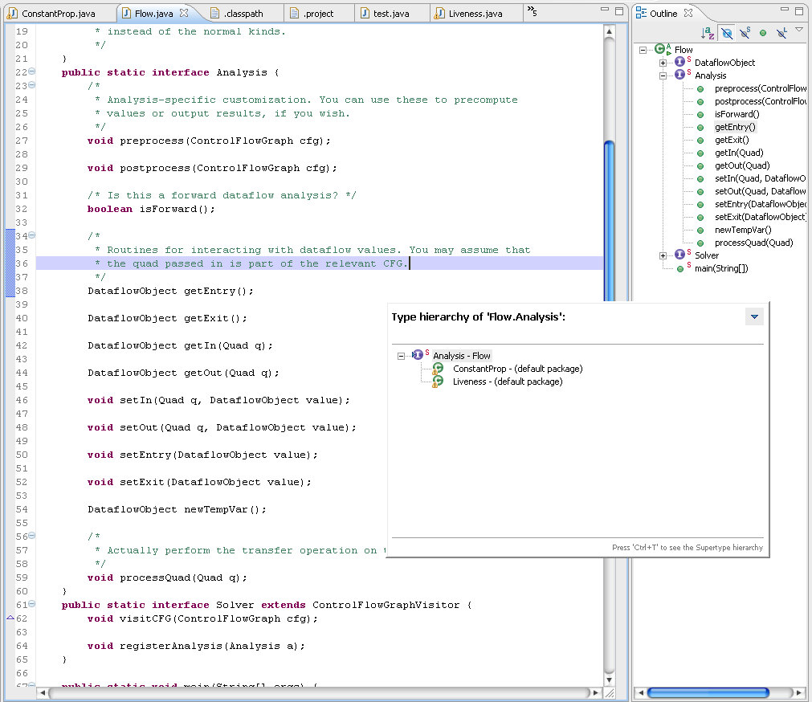
Flow.Analysis Interface
You implement
  the solver and
  reaching definitions
Test it first on the provided input
Compare the output with the canonical one
Be careful when writing your code
We will throw more test cases at it

